Slide 1
Language Translator
Team
IT024-Gajera Akshay Nandlalbhai-17ITUOS012
IT023-Fatehpuria Vandan-17ITUON089

Slide 2
Language Description
Our language is very simple, it identifies the strings made up of 'a' and 'b' in a specific sequence.
L: {a^{m}b^{n} | m>2&n>1 & m-n=1}
Example(valid)
aaabb
aaaabbb
Example(invalid)
aaaaaabb
aaabbbb
aaabbb

Slide 3
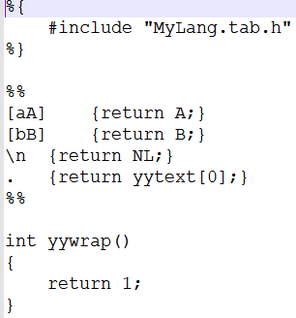
MyLang.l file

Slide 4
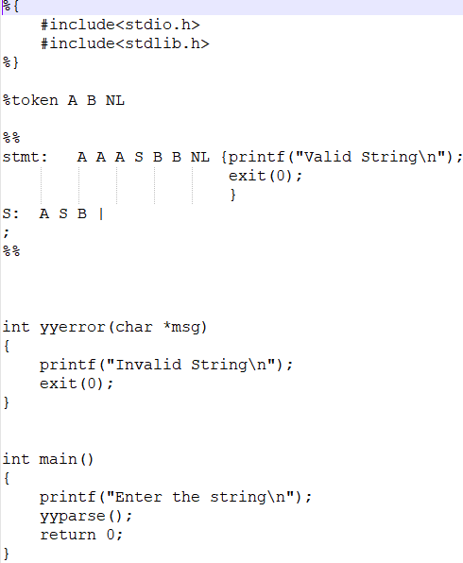
MyLang.y file

Slide 5





Inputs and Outputs of all secenarios

